Slide 1
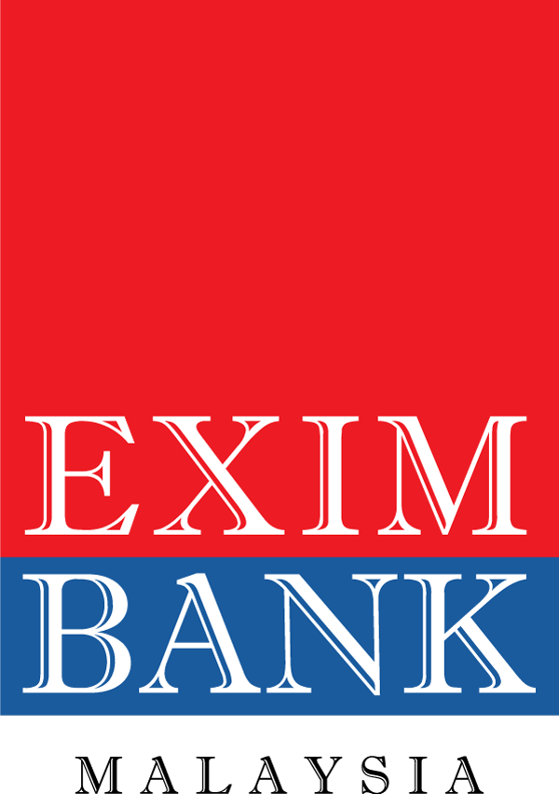
LOAN GROWTH MODEL
MARCH 2024
Prepared by:
Strategic Planning Department
8 MARCH 2024

Slide 2
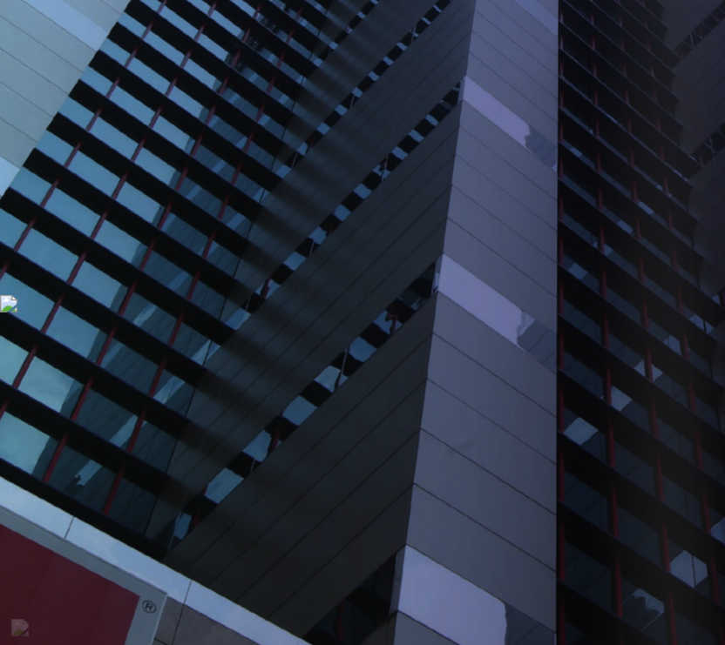
1
Introduction
2
Factors
Agenda
3
Correlation Analysis
4
Multivariate Analysis
5
Projection
6
Conclusion

Slide 3
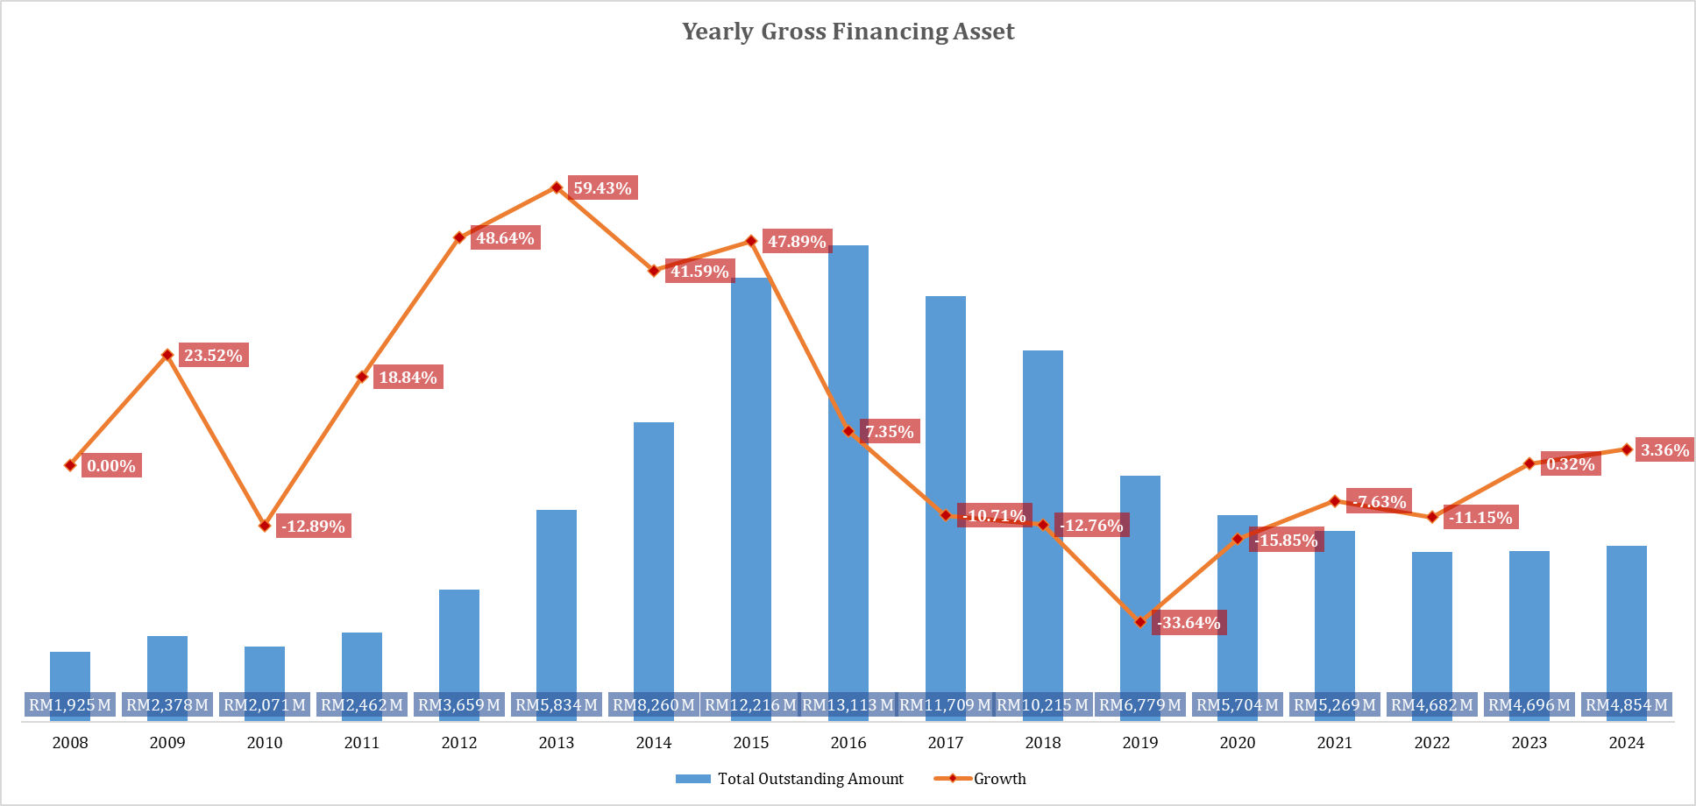
Introduction
EXIM Bank’s Yearly Performance
Research Questions
The figure shows the EXIM bank borrowing asset performance, while below shows the Measures of Central Tendency of the Yearly Gross Financing Asset Performance:
CAGR Gross financing asset of 5.59%
Minimum total borrowing of RM 1,925 M & -33.64% growth
Maximum total borrowing of RM 13,113 M & 59.43% growth
Average total borrowing of RM 6,225 M Quarterly & 9.14% growth
Standard deviation total borrowing of RM 3,649 M & 27.77% growth
Based on the performance below, the research question is as follows:
What are the main factors that driven loan growth in EXIM bank?

Slide 4
Process Flow
Start
External
Internal
Correlation Analysis
Multivariate Analysis
Projection
End

Slide 5
Factors
Internal
External
Disbursed Account
US Dollar Index
GDP (MY & US)
Measures the capability of EXIM Bank to disburse loan.
Measures the value of the US dollar against a basket of six major currencies: the euro (EUR), Japanese yen (JPY), British pound (GBP), Canadian dollar (CAD), Swedish krona (SEK), and Swiss franc (CHF).
Measures the total market value of all final goods and services produced within its border during a specific period.
No. of Application
FX (USD to MYR)
Fed Funds Target
Number of application pending to become EXIM customer.
The exchange rate between the US Dollar and Malaysian Ringgit, impacting trade, investment, and economic stability in Malaysia
The interest rate for US Banks lending cash set by the Federal Reserve that influences the entire economy.
Definition
Staff Strength
OPR
FTSE Bursa Malaysia KLCI
Number of staff working in EXIM Bank by front office and back office on day-to-day operation.
Overnight Policy Rate is interest rate set by the central bank impacting borrowing and lending costs, influencing the economy..
The benchmark stock index for Malaysia.
Disbursed Account: EXIM Bank’s capability to disbursed loan will increase the gross financing asset.
No. of Application: Indicate the possibility of maximum potential customer EXIM Bank can do business.
Staff Strength: Increase in staff will possibly leads to better performance.
USD Dollar Index: Weaking USD makes borrowing USD cheaper, potentially loan growth by lower interest rates
FX: Appreciation of RM reduces of foreign currency-denominated debt, potentially allowing for loan growth
OPR: OPR increase makes borrowing more expensive due to increased of cost of fund.
GDP: Stronger GDP indicates a growing economy with potentially higher demand for financing, leading to faster loan growth
Fed Funds Target Rate: Falling rate reduces borrowing costs and potentially encourages new borrowing, leading to faster growth
FTSE Bursa Malaysia KLCI: Rising stock market shows investor confidence and potentially easier access to capital, leading to faster loan growth
Justification

Slide 6
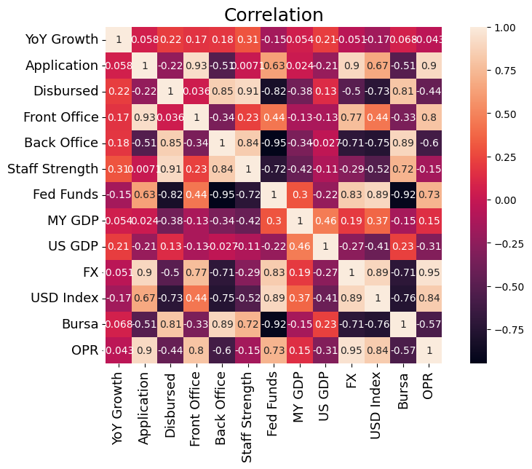
Correlation Analysis
Interpretations
There is no high correlation among the factors but there is a moderate/weak correlation contribute to the growth.
Most of the factor is positively correlated and only portions are negatively correlated that is fed funds target, FX and USD index.
The correlation indicate that EXIM Bank asset growth had been influenced mostly by internal factors compared to external factors.
Historically against the loan, the number of staff is the highest factor contributing to our growth and some main factor to the loan growth are increase of disbursed accounts, increase in staff strength and the strengthen of US GDP.
number of disbursed accounts need to improve to increase number of application.
Front office is more important in loan growth more than back office.
MY market has small impact to the business compared to US market.

Slide 7
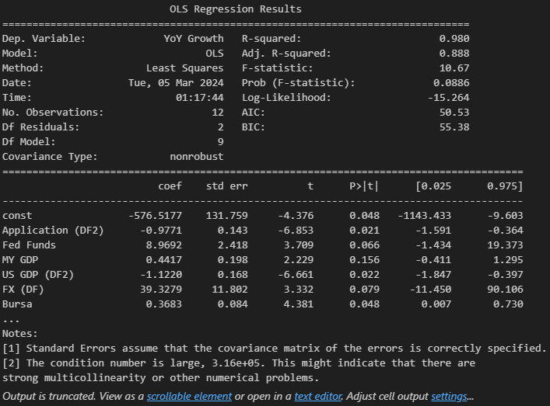
Multivariate Analysis
Growth Model
Out of 10 variable obtained, only 9 is shown as significance while 1 variable (Disbursed Accounts) is removed to strengthen forecast model of loan projection in deciding the direction of whether loan growth.
Model shows 98% accuracy and reliable for projections.
Variable and factor are listed as per below:
Variable | Factor
No. of Application | Internal
Staff Strength | Internal
Fed Funds Target | External
GDP (MY & US) | External
FX (USD to MYR) | External
FTSE Bursa Malaysia KLCI | External
OPR | External
US Dollar Index | External

Slide 8
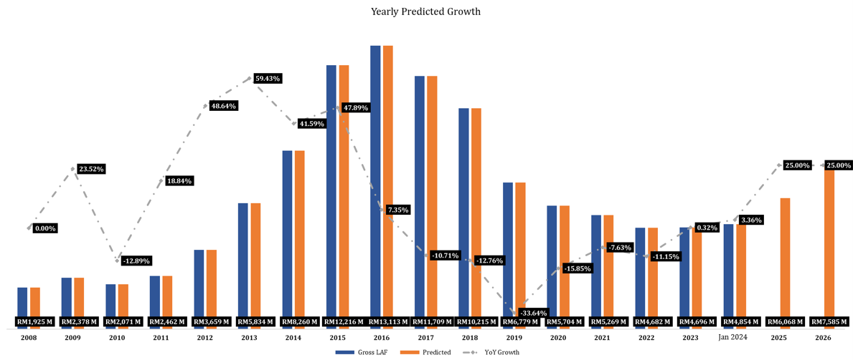
Projection
Projections
Variable | Current | Requirement | Transition
No. of Application | 53 | 63
Staff Strength | 324 | 346
Fed Funds Target | 5.25 | 4.27
GDP (Malaysia) | 3.40 | -16.60
GDP (US) | 3.10 | 10.97
FX (USD to MYR) | 4.70 | 4.47
FTSE Bursa Malaysia KLCI | 1447.04 | 1423.06
OPR | 3.00 | 2.84
US Dollar Index | 104.53 | 111.19
The model indicates that the optimum control to grow is the increase in manpower and business while the strengthen of cross border economy with low cost to the Malaysian country.
The situation is very unlikely to control because it is expected to negate the requirement except the internal factors such as manpower and no. of application that can be work on to meet the requirement.
Though the Malaysian Bank Negara Economic & Monetary Review expect the economy to expand between 4.0% to 5.0%, the global economic is potentially slowdowns in major economies, particularly China that could impact Malaysia's export-oriented industries and the Global Geopolitical tensions is uncertain that could disrupt the global trade and supply chains.
The US economy’s rising of consumer debt and elevated interest rates is as well could potentially slow down the economic growth particularly in consumer spending.

Slide 9
Conclusion
Recommendation
The model indicates realistic number for EXIM bank to achieve and the effectiveness is likely and reliable with high accuracy of 98% and the internal factors such as manpower and no. of application can be work on to meet the requirement.
Main factors that driven the loan to grow is to work on the internal factors and the strengthen of US GDP, but it is unlikely for US to strengthen rapidly rather it will grow slowly due to effects of monetary policy, larger fiscal boost, dropped in housing sector activity, supply chain bottlenecks and geopolitical risk. The US economies also has rising of consumer debt and elevated interest rates is as well could potentially slow down the economic growth particularly in consumer spending.
Though the Malaysian Bank Negara Economic & Monetary Review expect the economy to expand between 4.0% to 5.0%, the global economic is potentially slowdowns in major economies, particularly China that could impact Malaysia's export-oriented industries and the Global Geopolitical tensions is uncertain that could disrupt the global trade and supply chains.
Historically against the loan, increase the number of staff has shown growth in loan mainly from front office. number of disbursed accounts need to improve to increase number of application.

Slide 10
Thank You

